Slide 1

Object Detection Evalution
Raghu Prasad Konandur
9845547471
www.kaushalya.tech
raghuprasadkonandur@kaushalya.tech

Slide 2
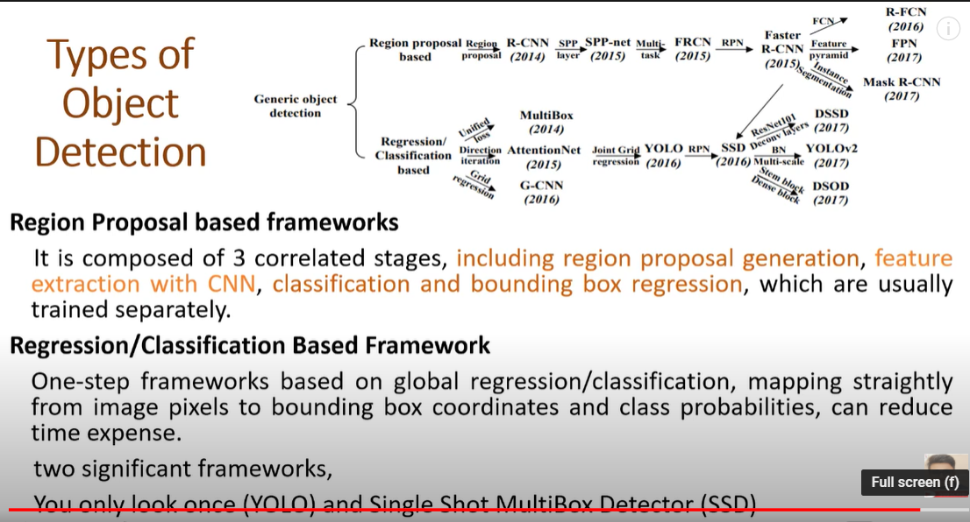
Types of object detection

Slide 3
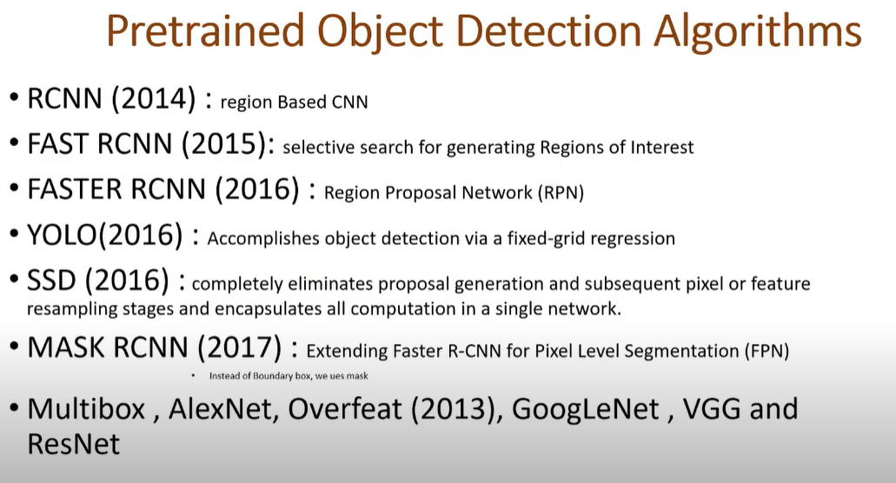
Pretrained Object Detection Algorithms

Slide 4
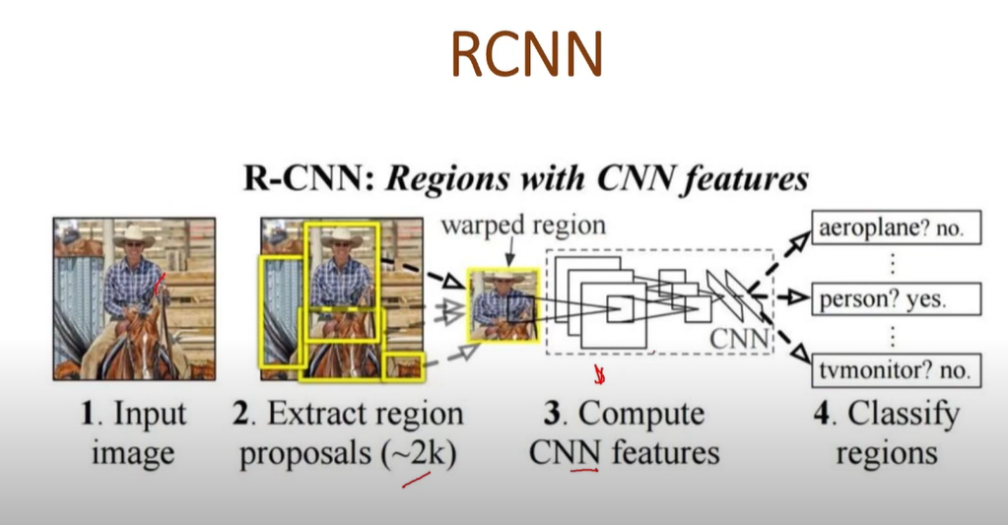
RCNN

Slide 5
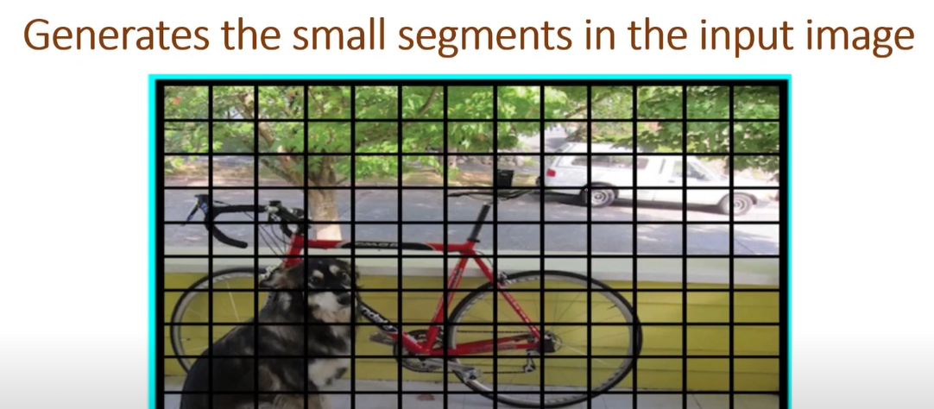
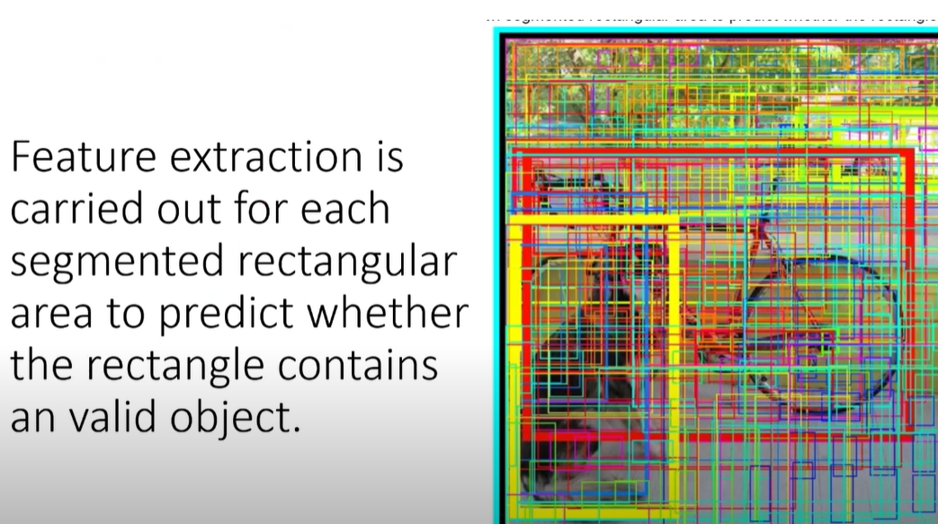
RCNN

Slide 6
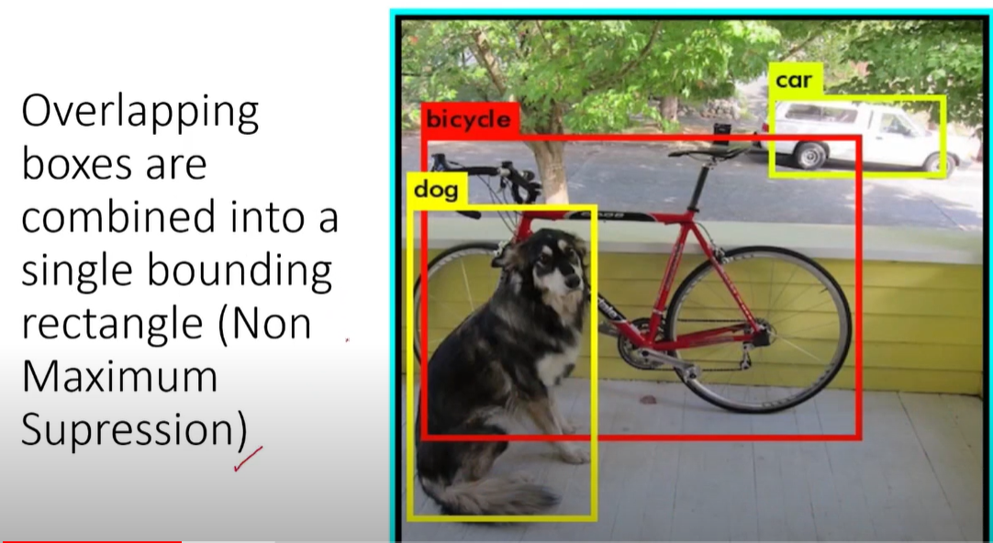
RCNN

Slide 7
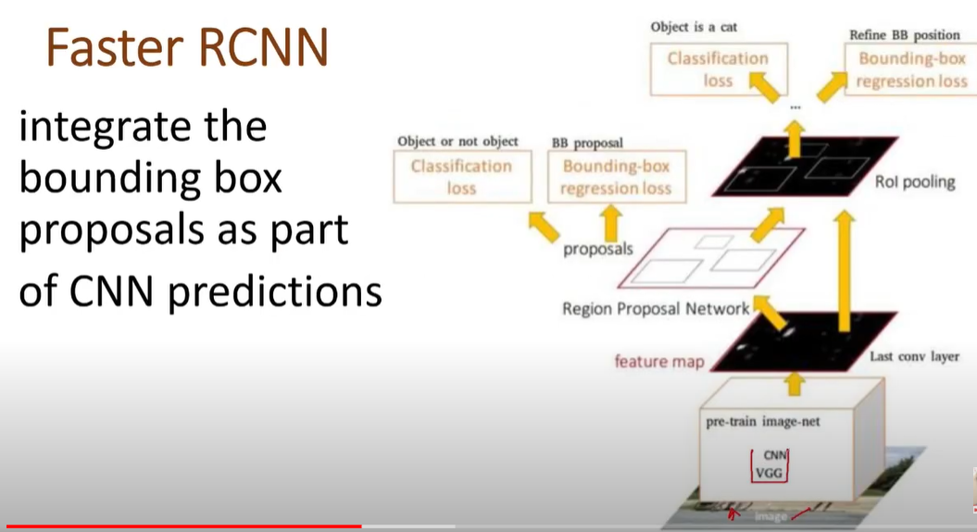
Faster RCNN

Slide 8
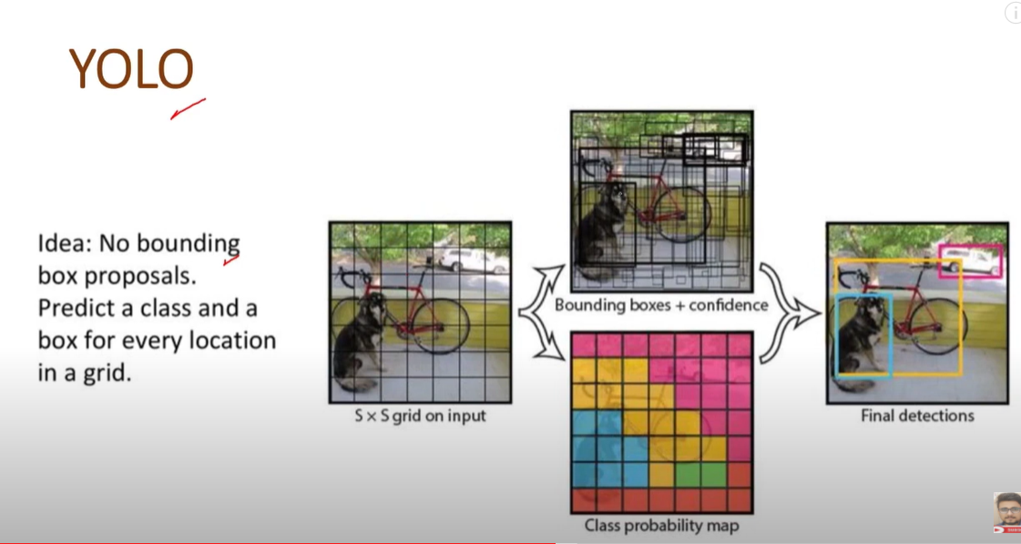
YOLO

Slide 9
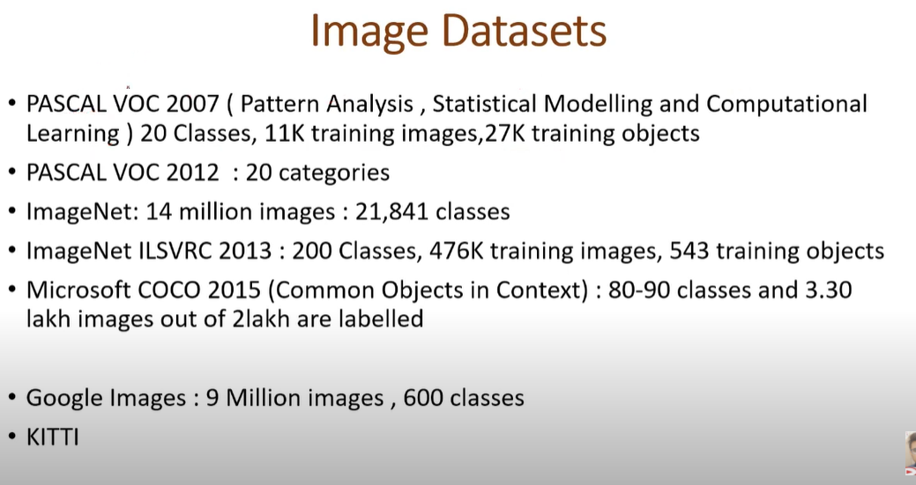
Image Datasets

Slide 10
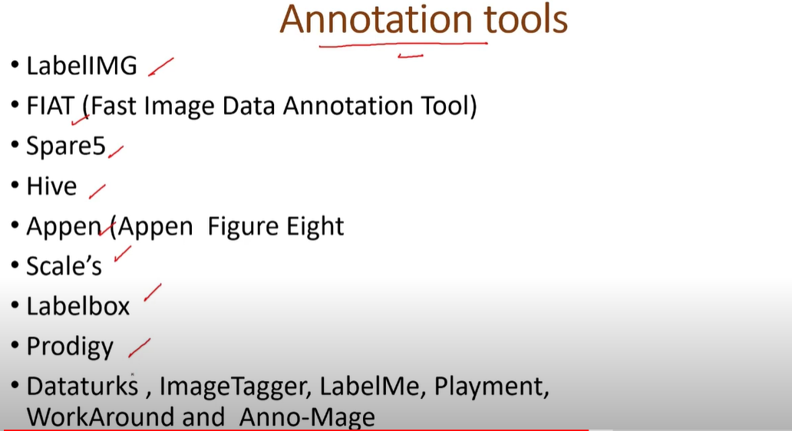
Annotation tools

Slide 11
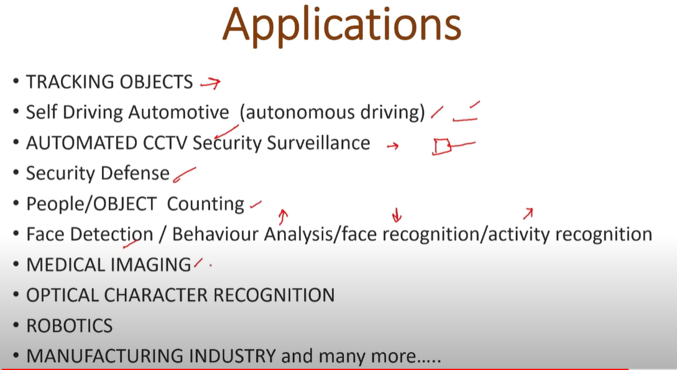
Applications

Slide 12
Reference
https://towardsdatascience.com/r-cnn-fast-r-cnn-faster-r-cnn-yolo-object-detection-algorithms-36d53571365e
https://www.youtube.com/watch?v=1MthLfi8HnU

Slide 13
Thank You
Raghu Prasad Konandur
9845547471
www.kaushalya.tech
raghuprasadkonandur@kaushalya.tech

